Slide 1
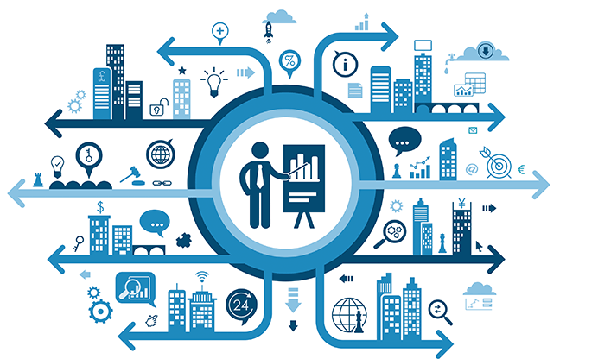
What is BIG DATA?

Slide 2
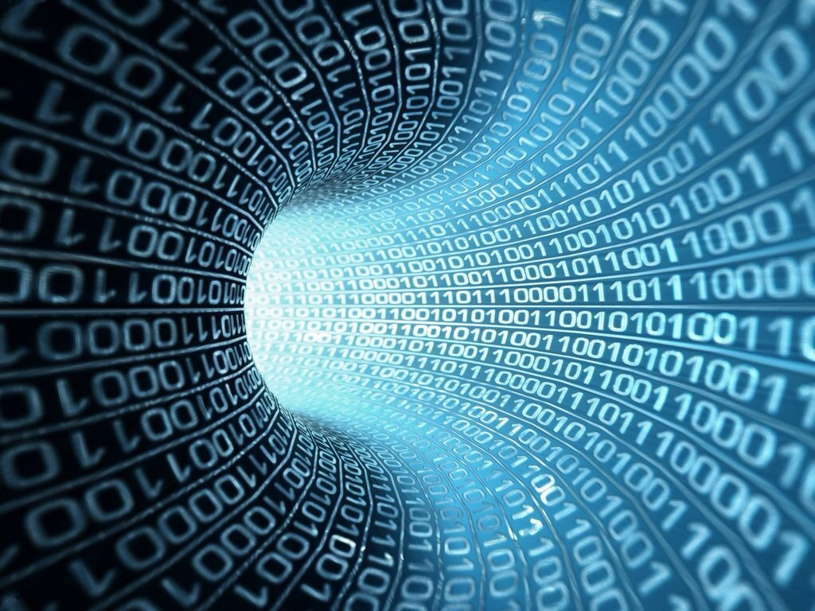
What is Data?
In computing, data is information that has been translated into a form that is efficient for movement or processing.
Relative to today's computers and transmission media, data is information converted into binary digital form.
Raw data is a term used to describe data in its most basic digital format.

Slide 3
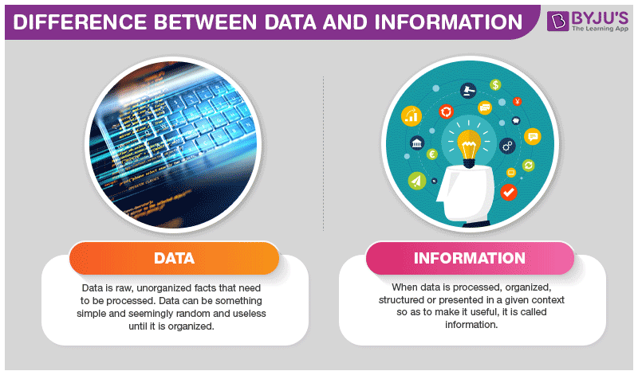

Slide 4
What is BIG DATA?

Slide 5
Big Data is a collection of data that is huge in volume, yet growing exponentially with time. It is a data with so large size and complexity that none of traditional data management tools can store it or process it efficiently. Big data is also a data but with huge size.

Slide 6
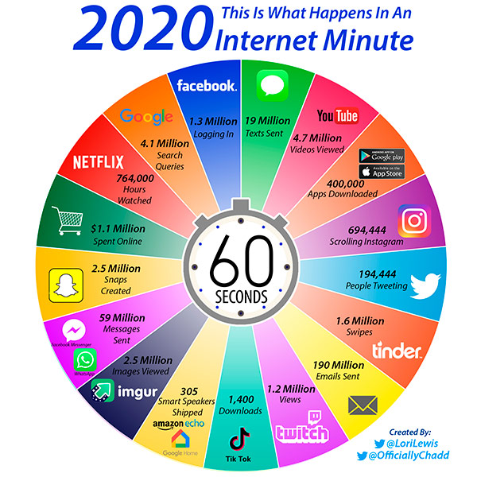

Slide 7
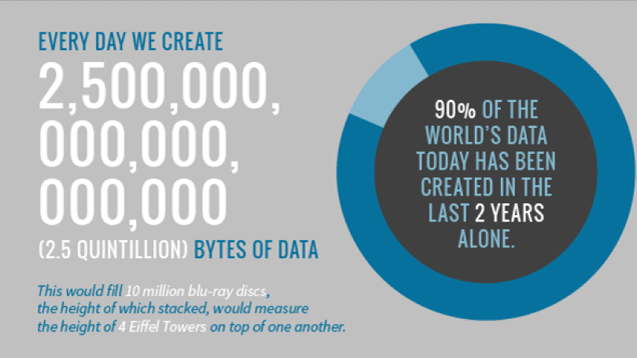

Slide 8
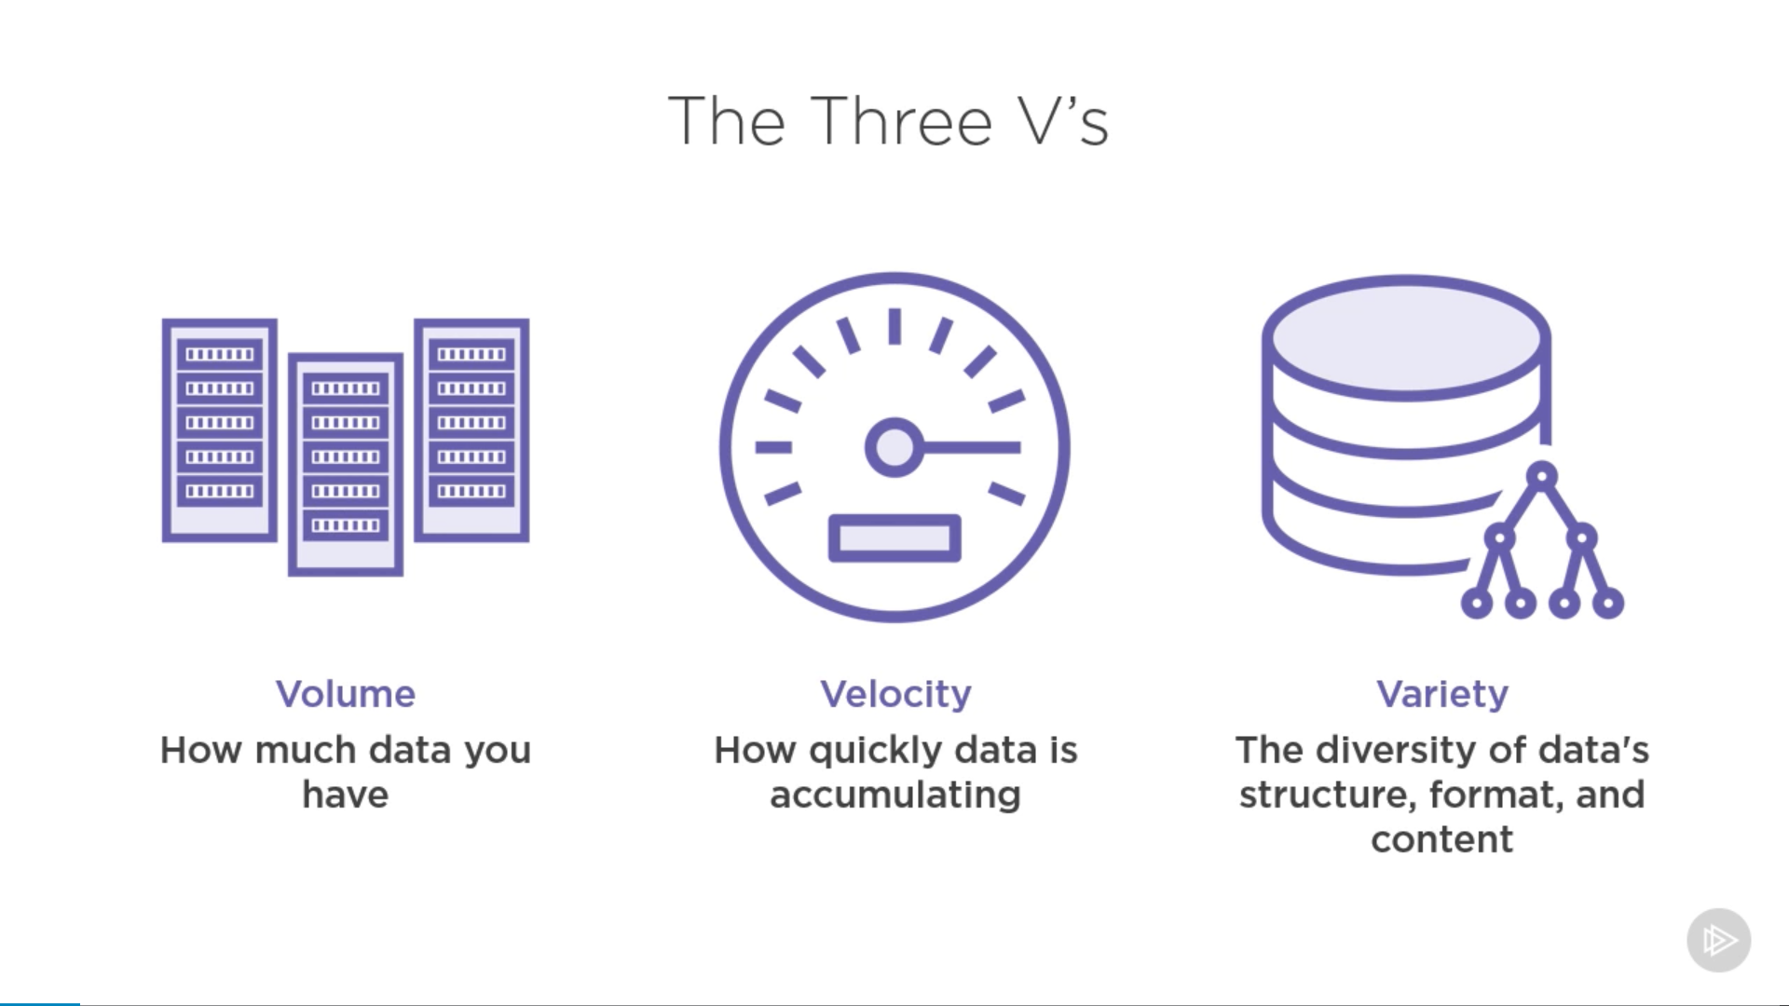

Slide 9
Benefits of Big Data Processing
Ability to process Big Data brings in multiple benefits, such as-
Businesses can utilize outside intelligence while taking decisions
Decisions making
Improved customer service
Early identification of risk to the product/services, if any
Better operational efficiency

